Slide 1
Week 2 Hands On Assignment Data Wrangling Project
DASC1042:Data Wrangling and Visualization

Slide 2
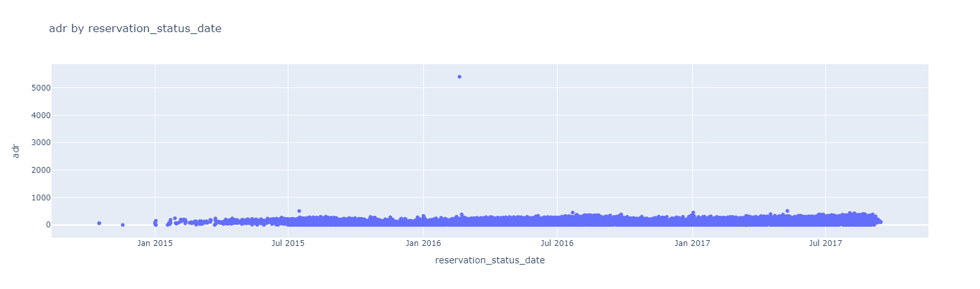
Hotel Booking Demands
On Feb 19, 2016, the adr was at 5400.
That value seems to be an outlier: it must have been entered incorrectly.

Slide 3
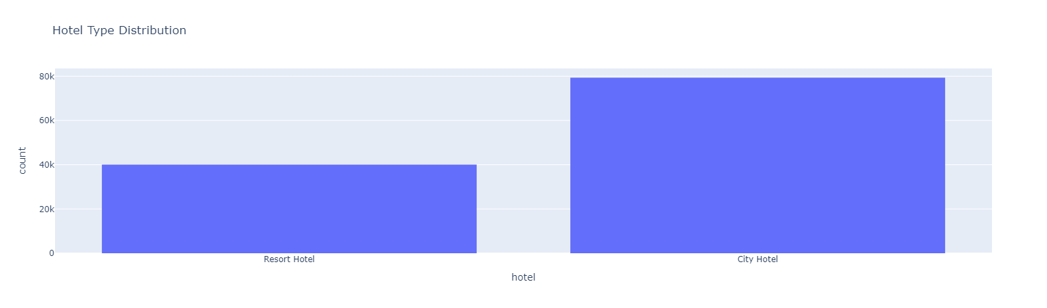
Hotel Booking Demands
City hotel has more demands with 79,330 reservations while resort hotel has 40,060 reservations.

Slide 4
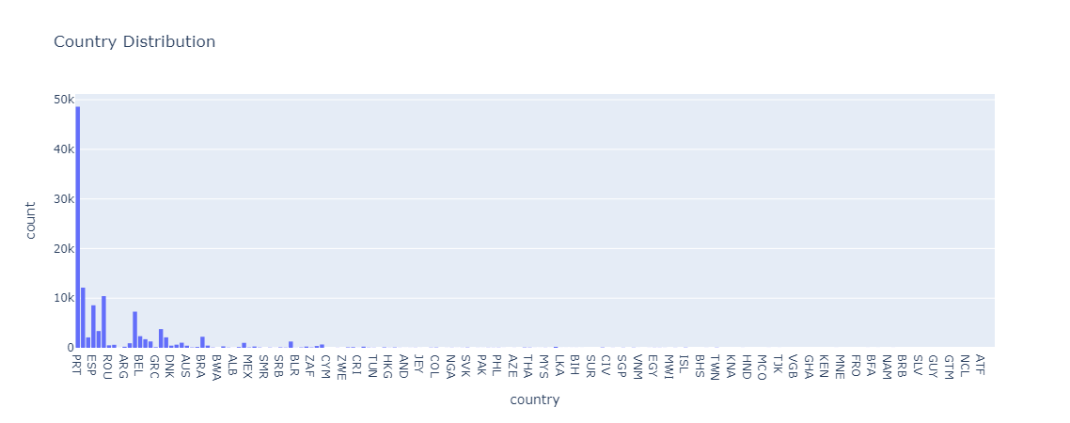
Hotel Booking Demands
The top 3 countries with highest hotel bookings are:
Portugal (PRT) 48.59k
Great Britain (GBR) 12.129k
France (FRA) 10.415k

Slide 5
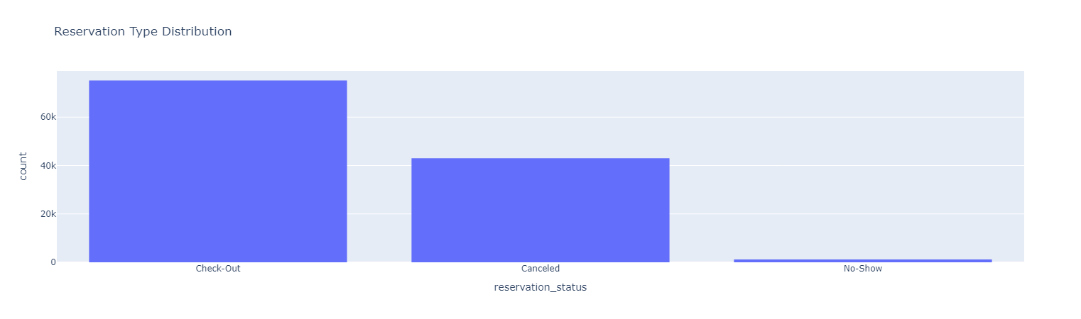
Hotel Booking Demands
75,166 reservations are checked out while 43,017 reservations are cancelled.

Slide 6
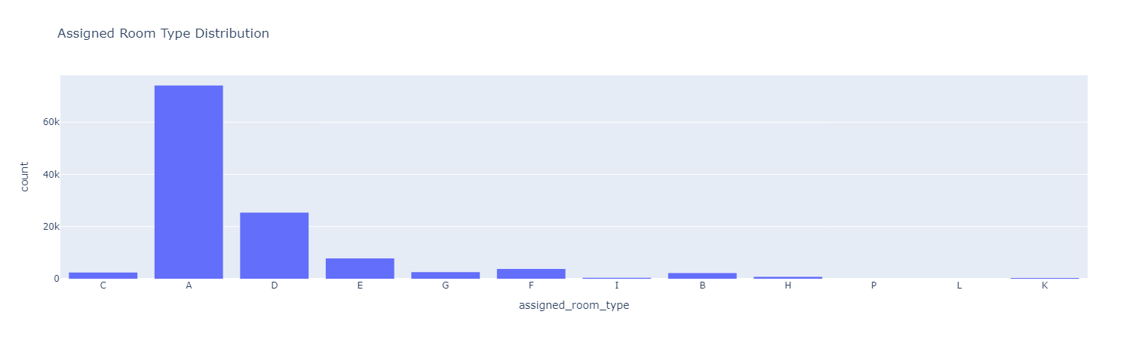
Hotel Booking Demands
The highest assigned room type is room type A with 74,053 assignments.

Slide 7
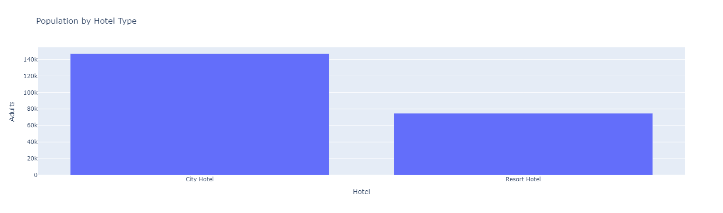
Hotel Booking Demands
Adults prefer to book with city hotel with 146,838 reservations when compared with resort hotel with 74,798 reservations.

